Slide 1

US Disaster Declarations Dashboard
Microsoft Power BI Project
Presented By: Yash Nandekar
Dataset: FEMA US Disaster Declarations

Slide 2
Project Overview
Project Goals
1
Analyze FEMA disaster declaration data
Identify disaster-prone states
Study disaster trends over time
Compare IA, PA, and HM assistance programs
Perform scenario analysis using a What-If parameter
Build an optimized Power BI dashboard
The objective of this project is to design and develop an interactive Power BI dashboard that analyzes FEMA disaster declaration data across the United States. The dashboard enables users to identify disaster trends, analyze affected regions, compare FEMA assistance programs, and perform scenario analysis using a What-If parameter.

Slide 3
Dataset Overview
Dataset Information
Important Columns
Disaster Number
State
Incident Type
Declaration Date
Incident Begin Date
Incident End Date
IA Program Declared
PA Program Declared
HM Program Declared
Attribute | Details
Dataset | FEMA US Disaster Declarations
Source | FEMA Open Data
Format | CSV
Records | 64,091
Tool | Microsoft Power BI

Slide 4
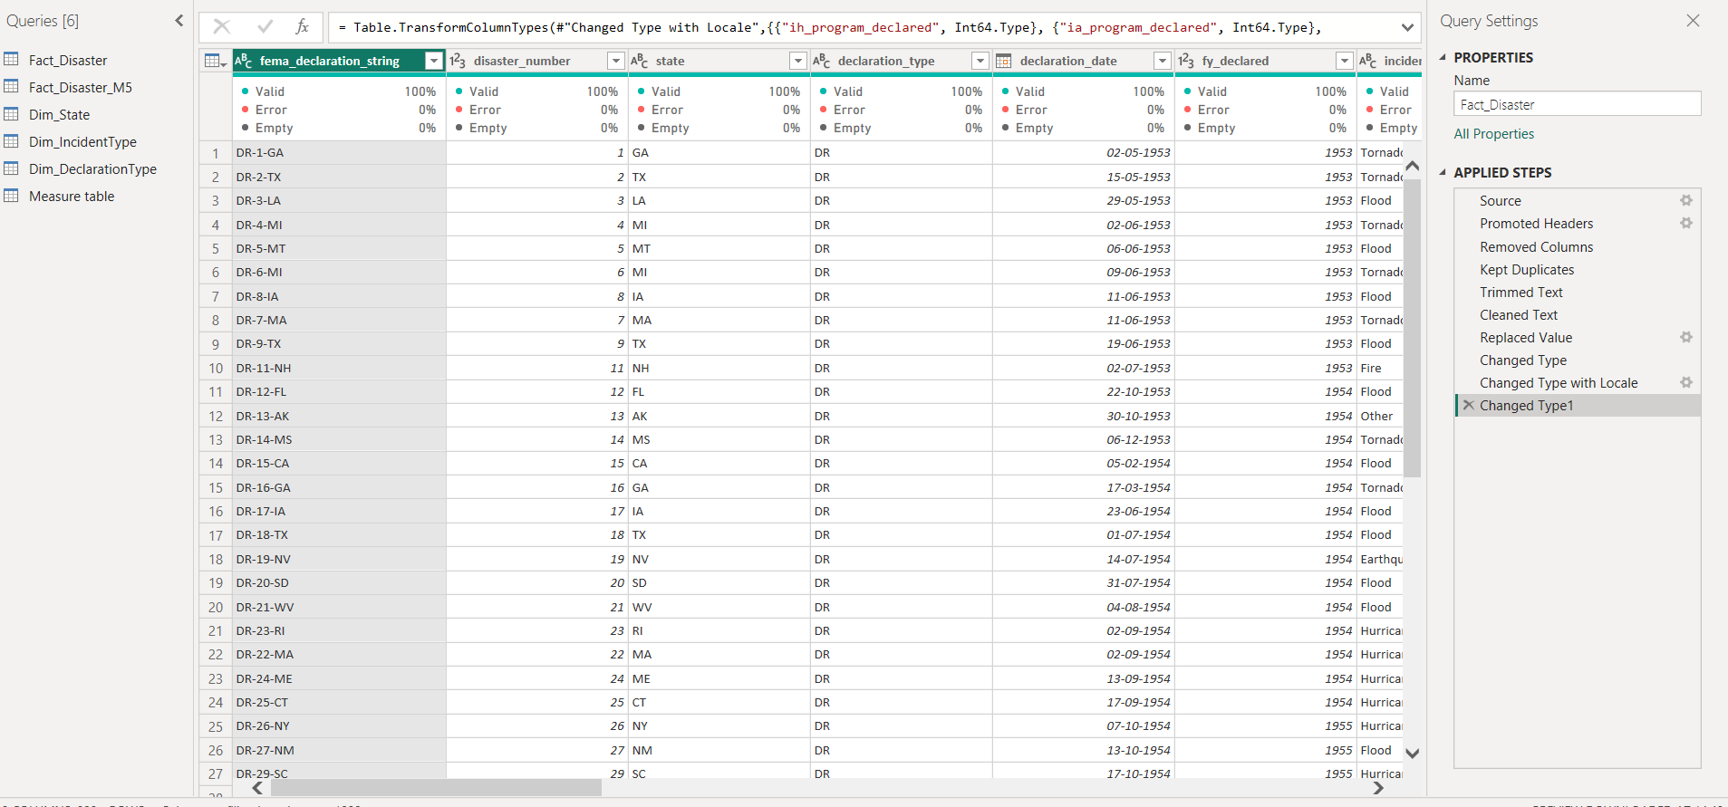
Power Query Transformations
Data Cleaning & Transformation Steps
✅ Imported FEMA Disaster Declarations CSV dataset
✅ Promoted the first row as column headers
✅ Removed unnecessary columns (id, hash, last_ia_filing_date)
✅ Trimmed leading and trailing spaces from text fields
✅ Cleaned non-printable characters from text columns
✅ Replaced invalid values (NA) with Null
✅ Converted columns to appropriate data types (Date, Number, Text)
✅ Created calculated columns:
Disaster Duration
Time To Declaration
✅ Loaded the cleaned dataset into the Power BI model
Benefits
Improved data quality and consistency
Eliminated invalid and duplicate values
Ensured accurate DAX calculations
Enhanced dashboard performance
Prepared data for interactive reporting

Slide 5
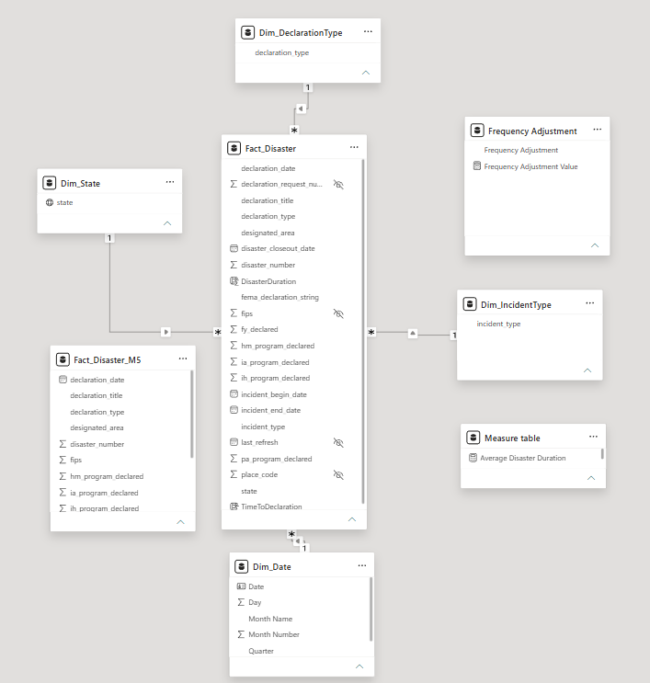
Data Model (Star Schema)
Data Model Structure
Fact Table: Fact_Disaster
Stores FEMA disaster declaration records.
Dimension Tables:
Dim_Date
Dim_State
Dim_IncidentType
Dim_DeclarationType
Relationships
Many-to-One relationships connect the Fact_Disaster table with each dimension table.
Dimension tables provide filtering and categorization, while the fact table stores measurable data.
Benefits
Improved report performance
Simplified relationships
Faster DAX calculations
Better scalability and easier maintenance

Slide 6
DAX Measures
Measure | Purpose
Total Disaster Declarations | Counts the total number of disaster declarations.
Total IA Declarations | Counts Individual Assistance (IA) declarations.
Total PA Declarations | Counts Public Assistance (PA) declarations.
Total HM Declarations | Counts Hazard Mitigation (HM) declarations.
Average Disaster Duration | Calculates the average duration of disasters.
Average Time To Declaration | Calculates the average time between incident start and declaration.
Projected PA Funding | Estimates projected Public Assistance funding using the What-If parameter.
Projected IA Declarations | Projects Individual Assistance declarations based on the selected scenario.
Frequency Adjustment Value | Captures the user-selected What-If percentage for scenario analysis.
Business Value
Dynamic KPI calculations
Real-time filtering and aggregation
Interactive scenario analysis
Faster and reusable calculations
Supports data-driven decision making DAX Features Used
Aggregation Functions: SUM, COUNTROWS, DISTINCTCOUNT, AVERAGE
Filter Functions: CALCULATE, FILTER
Logical Functions: IF, SELECTEDVALUE
Variables: VAR, RETURN
Scenario Analysis: What-If Parameter

Slide 7
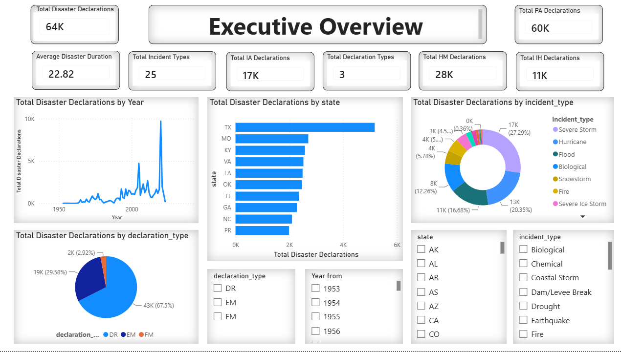
Dashboard - Page 1: Executive Overview
Visuals Used
📊 KPI Cards
Total Disaster Declarations
Total IA Declarations
Total PA Declarations
Total HM Declarations
Average Disaster Duration
📈 Line Chart
Disaster declaration trends over time
📊 Column/Bar Chart
Comparison of disaster declarations
🥧 Pie/Donut Chart
Distribution of FEMA assistance programs
🎛 Interactive Slicers
Year
State
Incident Type
Declaration Type
Key Insights
Displays overall disaster declaration statistics.
Highlights FEMA assistance program distribution.
Identifies disaster trends over time.
Enables interactive filtering for detailed analysis.

Slide 8
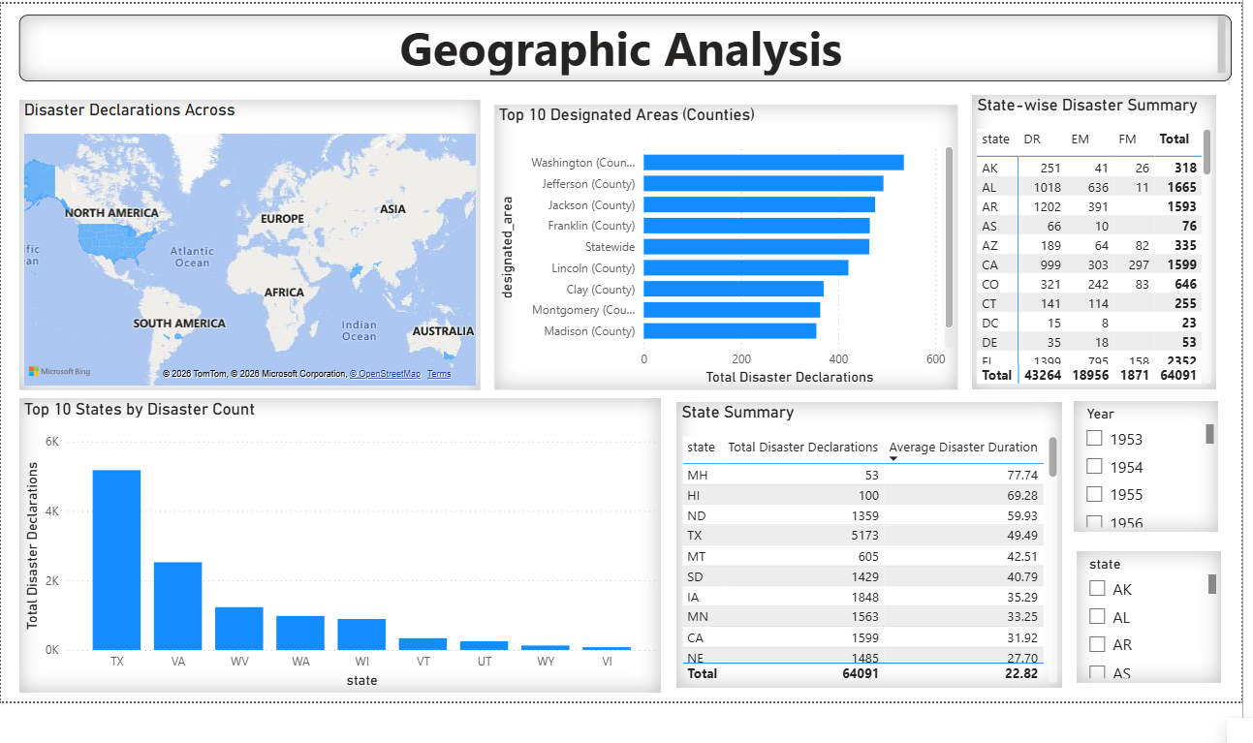
Dashboard - Page 2: Geographic Analysis
Visuals Used
🗺️ Map Visualization
Displays disaster declarations across U.S. states.
📊 Top 10 Designated Areas
Highlights counties with the highest number of disaster declarations.
📈 Top 10 States by Disaster Count
Compares disaster declaration counts across states.
📋 State-wise Disaster Summary
Shows DR, EM, FM declaration counts and total declarations by state.
📄 State Summary Table
Displays total disaster declarations and average disaster duration for each state.
🎛️ Interactive Slicers
Year and vState Key Insights
Texas recorded the highest number of disaster declarations.
Washington County had the highest disaster declarations among designated areas.
Users can analyze disasters at both state and county levels.
State-wise summaries provide quick comparison of declaration types and disaster duration.

Slide 9
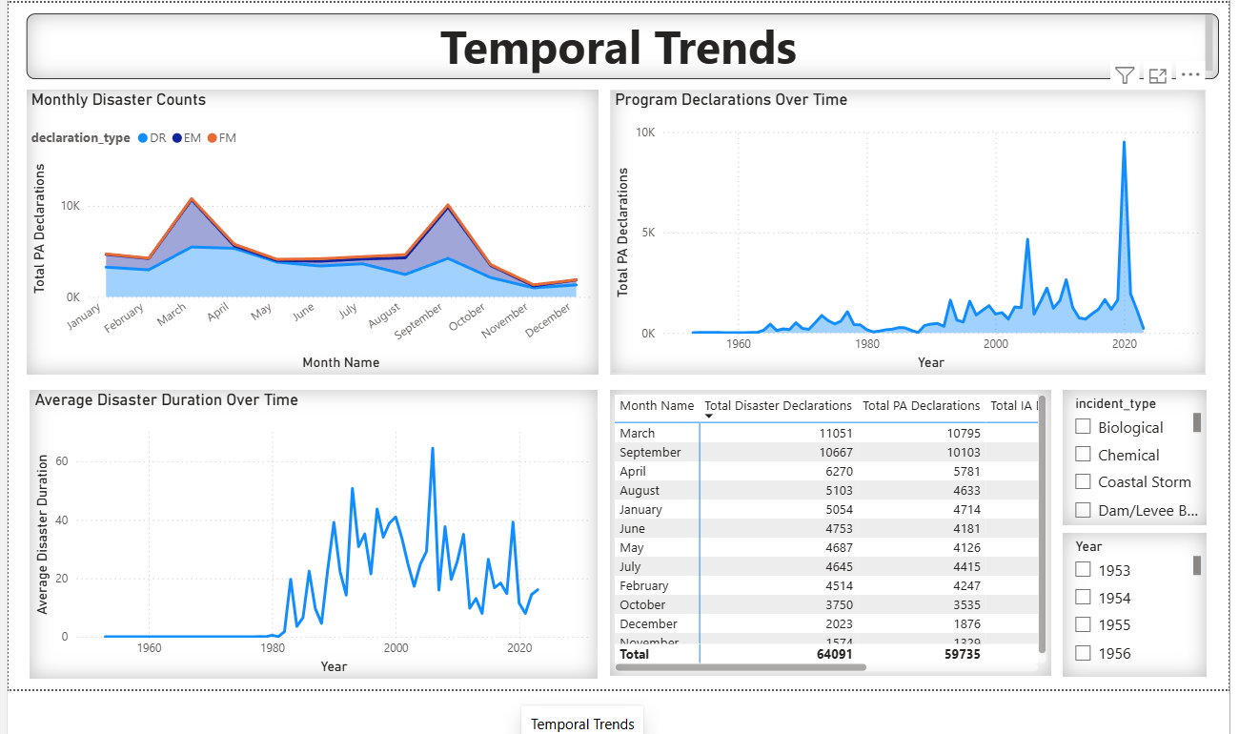
Dashboard - Page 3: Temporal Trends
Visuals Used
📊 Monthly Disaster Counts (Area Chart)
Compares monthly disaster declarations by Declaration Type (DR, EM, FM).
📈 Program Declarations Over Time (Line Chart)
Shows disaster declaration trends across different years.
📉 Average Disaster Duration Over Time (Line Chart)
Displays changes in average disaster duration over the years.
📋 Monthly Summary Table
Shows Total Disaster Declarations, Total PA Declarations, and Total IA Declarations by month.
🎛️ Interactive Slicers
Incident Type
Year
Key Insights
March and September recorded the highest number of disaster declarations.
Disaster declarations have increased significantly in recent years.
Average disaster duration varies across different years.
Monthly summary enables comparison of Total, IA, and PA declarations.

Slide 10
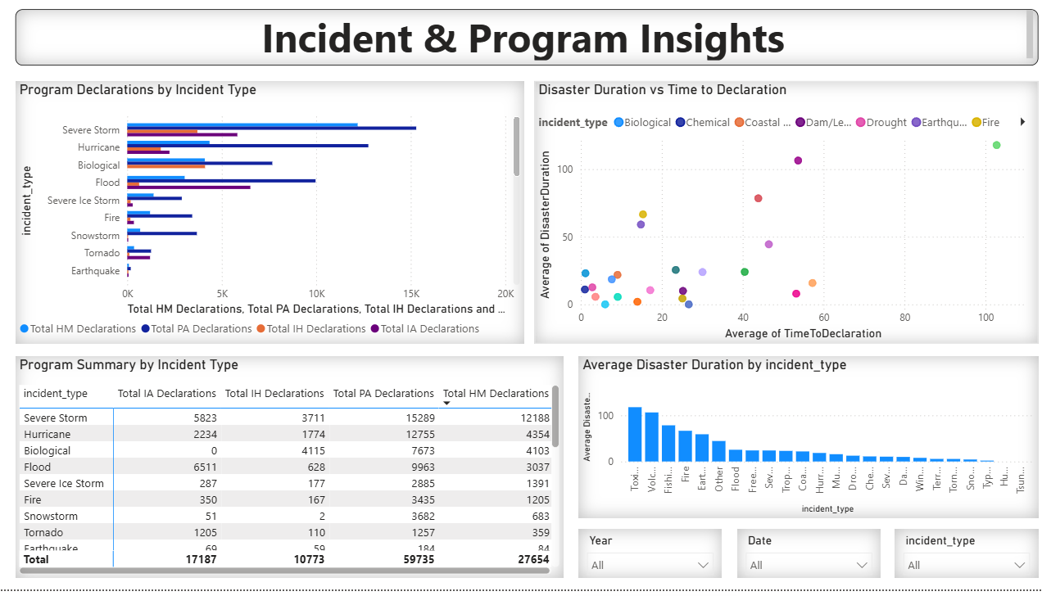
Dashboard - Page 4: Incident & Program Insights
Visuals Used
📊 Program Declarations by Incident Type (Bar Chart)
Compares IA, IH, PA, and HM declarations across different incident types.
📈 Disaster Duration vs Time to Declaration (Scatter Chart)
Analyzes the relationship between declaration time and disaster duration.
📋 Program Summary by Incident Type (Table)
Displays IA, IH, PA, and HM declaration counts for each incident type.
📊 Average Disaster Duration by Incident Type (Column Chart)
Compares average disaster duration across incident types.
🎛️ Interactive Slicers
Year
Date
Incident Type
Key Insights
Severe Storms and Hurricanes account for the highest number of program declarations.
PA declarations are the most common assistance program across incident types.
Disaster duration varies significantly depending on the incident type.
Scatter chart helps identify incidents with longer response and recovery durations.

Slide 11
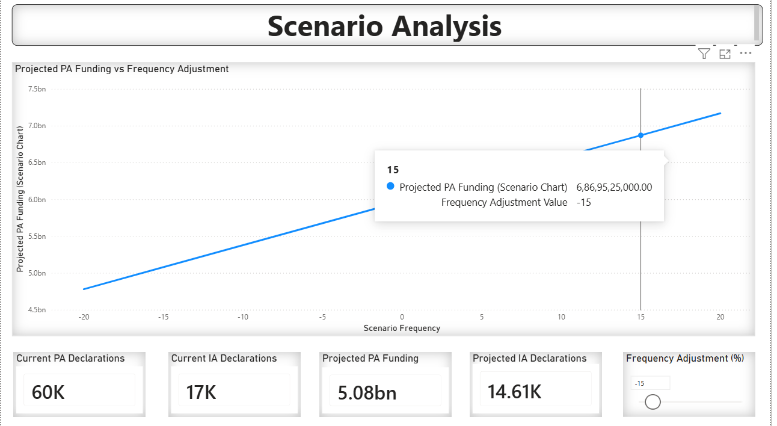
Dashboard - Page 5: Scenario Analysis
Visuals Used
📈 Projected PA Funding vs Frequency Adjustment (Line Chart)
Displays projected PA funding across different frequency adjustment percentages.
📊 KPI Cards
Current PA Declarations
Current IA Declarations
Projected PA Funding
Projected IA Declarations
🎚️ What-If Parameter (Slider)
Allows users to adjust the frequency percentage from -20% to +20%.
Dynamically updates all projected values and visuals.
Key Insights
Positive frequency adjustments increase projected PA funding and IA declarations.
Negative adjustments decrease projected funding estimates.
Current values remain available for comparison with projected values.
Users can instantly visualize the financial impact of different scenarios.

Slide 12
Technical Implementation
Implementation Workflow
📥 Data Import
Imported FEMA disaster declaration dataset (CSV).
🧹 Data Preparation
Cleaned and transformed data using Power Query.
Converted data types and handled missing values.
🗂️ Data Modeling
Built a Star Schema with one Fact table and four Dimension tables.
📊 Report Development
Created KPIs, charts, maps, tables, and slicers.
Implemented five interactive dashboard pages.
🧮 Business Logic
Developed dynamic DAX measures for KPIs and projections.
Implemented What-If parameter for scenario analysis.
⚡ Performance Optimization
Removed unnecessary columns.
Used dimension tables to reduce redundancy.
Optimized DAX measures for better report performance
Technology Stack
Visualization Tool: Microsoft Power BI Desktop
Data Source: FEMA Disaster Declarations (CSV)
Data Transformation: Power Query (M Language)
Data Modeling: Star Schema
Calculations: DAX (Data Analysis Expressions)
Scenario Analysis: What-If Parameter
Deliverables
Interactive Power BI Dashboard
Technical Documentation
User Guide
Scenario Analysis using What-If Parameter

Slide 13
Project Challenges & Solutions
Challenge | Solution
Handling a large FEMA dataset (~64,000 records) | Optimized the data model using a Star Schema and removed unnecessary columns.
Date conversion errors caused by invalid "NA" values | Replaced invalid values with Null in Power Query before changing data types.
Creating dynamic scenario analysis | Implemented a What-If Parameter with DAX measures to dynamically calculate projected PA funding and IA declarations.
Building efficient DAX calculations | Used VAR, RETURN, and reusable measures to simplify calculations and improve performance.
Managing interactive dashboard filtering | Added slicers and established proper relationships between fact and dimension tables for accurate filtering.
Improving report performance | Hid unused columns, optimized visuals, and reduced unnecessary calculations for faster report loading.
Project Outcome
Successfully built a 5-page interactive Power BI dashboard.
Created dynamic KPIs and What-If scenario analysis.
Improved data quality through Power Query transformations.
Delivered an optimized and user-friendly reporting solution.

Slide 14
Conclusion
Project Summary
Successfully developed an interactive Power BI dashboard for analyzing FEMA Disaster Declarations.
Performed data cleaning and transformation using Power Query.
Implemented a Star Schema data model for efficient reporting.
Created dynamic DAX measures to calculate KPIs and business metrics.
Built 5 interactive dashboard pages covering Executive Overview, Geographic Analysis, Temporal Trends, Incident & Program Insights, and Scenario Analysis.
Integrated a What-If Parameter to perform scenario-based funding analysis.
Delivered a scalable, user-friendly dashboard that supports data-driven decision-making.
Key Learnings
Power Query for ETL and data preparation
Star Schema data modeling
Advanced DAX calculations
Interactive dashboard design
Performance optimization
What-If scenario analysis

Slide 15
Thank you

